Slide 1
Disability Culture
Presented by : STAC
(Students Taking Aim at Challenges)
Notes:
Hi, we are from STAC (Students Taking Aim at Challenges) we’re a disability advocacy club and we’re presenting Disability Culture.

Slide 2
Disability Culture? What is That?
“People with disabilities have forged a group identity. We share a common history of oppression and a common bond of resilience. We generate art, music, literature, and other expressions of our lives and our culture, infused from our experience of disability. Most importantly, we are proud of ourselves as people with disabilities. We claim our disabilities with pride as part of our identity. We are who we are: we are people with disabilities.”
(Brown, Movie Stars and Sensuous Scars, pp. 80-81)
Notes:
So I know probably a lot of the people here right now are thinking disability? How is that a culture?
Well Disability Culture is a group identity forged by disabled people out of a common bond of oppression and resilience. I think this quote from Steven Brown really puts it perfectly.
And from this bond, this group identity, we have generated paintings, music, literature and a plethora of other forms of art to express our unique view of life.

Slide 3
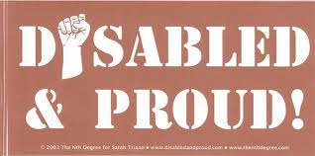
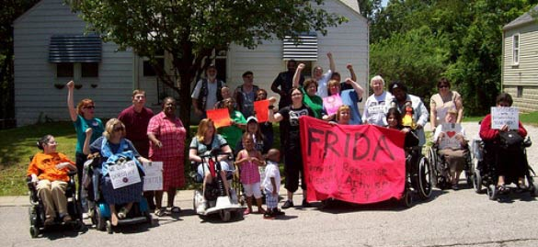
What are Some Common Beliefs and Values?
Disability Pride
Advocacy
Support
Notes:
Disability Pride means owning your disability, being able saying “I’m disabled” and being proud of that fact, knowing that being disabled doesn’t detract from who you are or what you can accomplish; it means being able to tell people with out feeling ashamed or embarrassed. The Disability Culture is really dedicated to promoting disability pride and spreading it.
It also is key part of advocacy and has really been built up in a counter to ableism (which for those of you who don’t know it’s a form of discrimination and social prejudice against people with disabilities). It’s counter to it because ableism is really the thought that we are a group of people to be pitied, less than or are useless and so being prideful about having a disability really flies in the face of that attitude
It is also provides support (emotional as well as through advocacy) for its members simply by having the shared experiences that were mentioned earlier, it provides comfort to it’s members to know that they’re not alone.

Slide 4
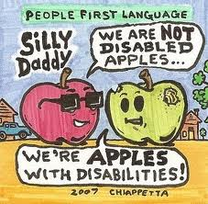
What are some of the things that disability culture advocates for?
Understanding NOT Pity
Accessibility
Respect
Disabled Perspective
Notes:
The disability community and culture has really evolved out of the need for self advocacy and is a major part of the community and culture at large.
Disabled Perspective: it is overall amorphous because it depends on the individual and their overall past experiences. There is a common saying that we’ve been repeatedly told since our childhoods: “treat others the way you want to be treated”.
Respect- Whenever people interact with a disabled person, Even people with good intention can unintentionally violate their autonomy. Some thing as trivial as speaking to them in a condescending manner can be demeaning to the disabled person. Just because some has a disability does not mean that they want or need special treatment.

Slide 5
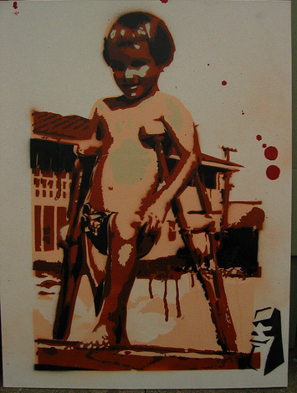
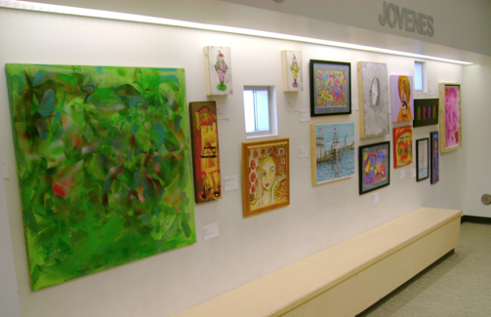
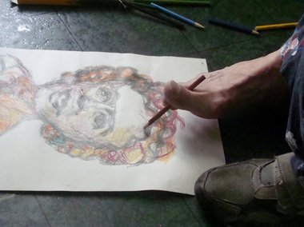
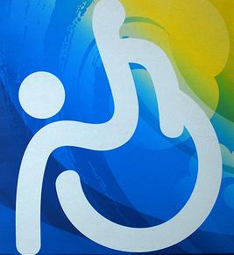
What is Disability Art?
Notes:
Disability Art is art that expresses disability themes. Art that expresses thoughts and feelings related to being disabled.
It often expresses the emotions involved with day to day struggles associated with living with a disability (social obstacle, physical obstacles and obstacles the disability may create itself) and to express feelings of empowerment and pride with a disability.

Slide 8
http://www.youtube.com/watch?v=rdLsRefSh58

